Slide 1

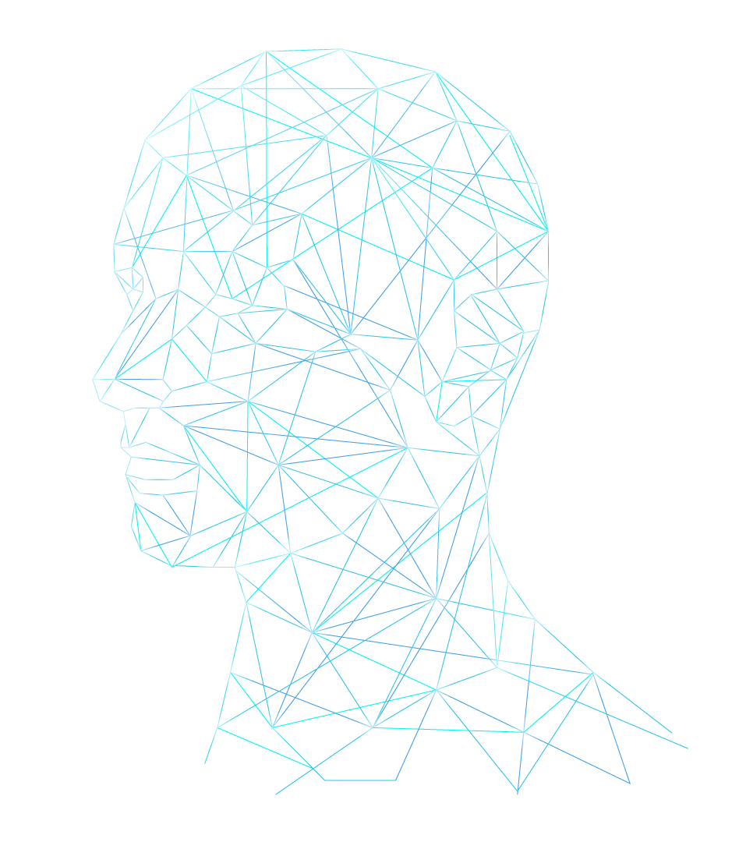
AI TECH IN SPORTS

Slide 2
INTRODUCTION
Artificial Intelligence, is a branch of computer science which covers a variety of what are called “smart” technologies. AI takes information and responds to it. AI can take mass amount of data and can analyse it. At the highest level, we can see self-driving cars and drones, but in a day-to-day practical way, it boils down to how computers can accumulate data and then apply it- learning, growing and making decisions on it.
AI can perform automated tasks, help do things better and more quickly, assist with better decisions and ultimately, automate decision-making processes that can be done without people.
AI technologies mimic humans ability to Sense, Think and Act.

Slide 3
AI ADVANTAGES IN SPORTS
COACHING & TRAINING
HEALTH CARE & SAFETY
AI provide us a way on how to perform tasks.
AI tells us what precautions to follow and in what manner.
WHAT AI CAN PROVIDE
TRAINING & ANALYSIS
FAN ENGAGEMENT
AI give us a better and easier way in traning.
Despite in performance, AI also encourage the engagement of fans in sports.

Slide 4
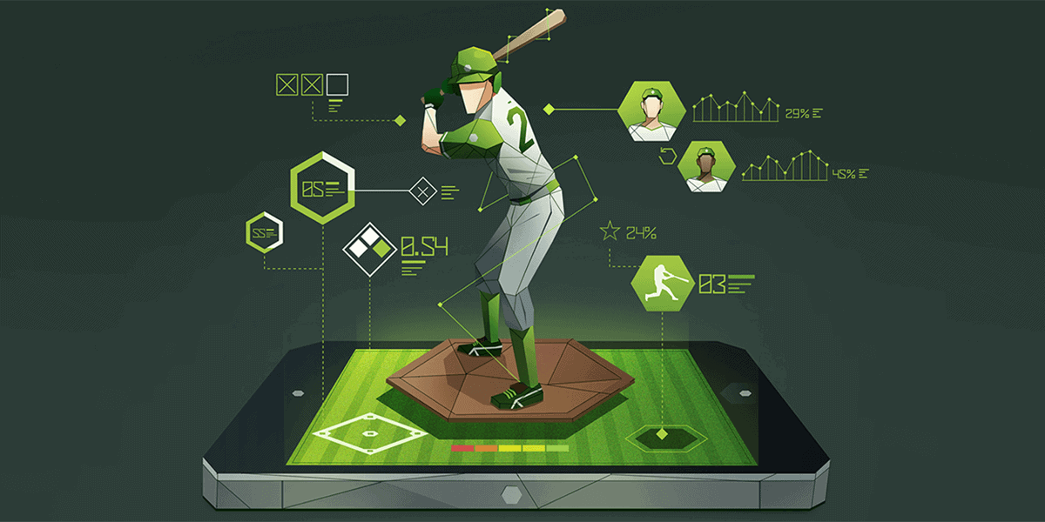
COACHING & TRAINING
How an athlete trains, analysis of their game performance and how a coach prepares their teams to tackle an opposition is rapidly changing with the advancement of technology.
AI applications containing data on a large number of training and game performances, coupled with knowledge from several expert sports scientists and coaches will act as a definitive central source of current knowledge.
AI provide us the correct, easier way of performing task. A coach can easily detect wrong performance of player with the help of AI and can train them in a better way.

Slide 5
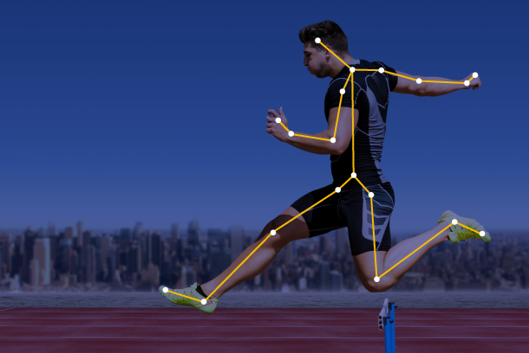
HEALTH CARE & SAFETY
Artificial intelligence is applied in sports through predictive analysis to improve performance and health. Athletes can prevent major injuries thanks to the development of wearables that collect data on degrees of strain and wear. This technology also allows for faster response times in emergency situations and better data-driven decisions about how best to reduce risk.
By comprehending many metrics, including spin, speed, serve placement, and even player posture and motion, artificial sports intelligence can enhance sporting performance further.

Slide 6
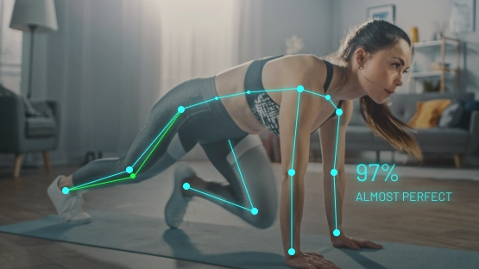
TRAINING & ANALYSIS
With the help of wearable technology, the athletes can gather information on strain and tear levels and can further avoid serious injuries. An AI diet plan uses machine learning to customize different meal plans for different players based on their needs and schedule.
The use of AI in sports training is boosting the effectiveness of each activity for each individual by creating customised training plans for players and providing real-time feedback. Teams can use AI to develop strategies and tactics and play to their strengths.

Slide 7
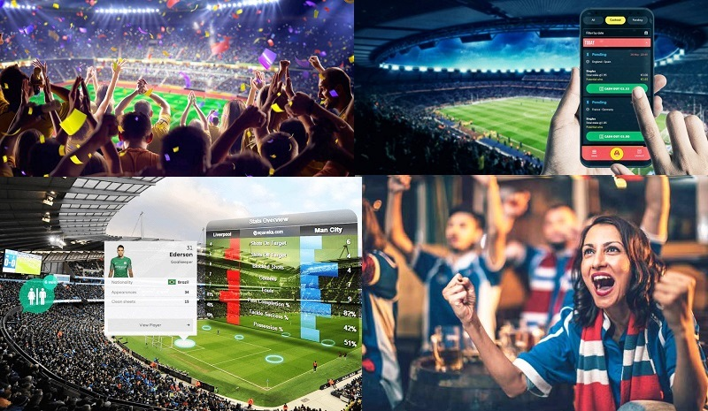
FAN ENGAGEMENT
With the help of AI now fans can easily get to know about their favorite player. AI provide fans access to their favorite teams through app. They can track their tickets, receive alerts when new stuff is available, find check-in locations on gameday, and keep an eye on the schedule. The predictive analysis can access player growth and develop potential and interest of fans towards the game. AI can suggest fans what they want by going through their previous data.
AI made people’s life easy by saving their time and suggesting them what they want to see.

Slide 8
CONCLUSION
AI provides countless options, and newer systems are constantly being developed, which can increase the variety of data processing options. With the advancement of artificial intelligence (AI), humans are now better able to predict the future than in the past. Because of the ability to digest information more quickly, we may now take on challenging tasks and study data from a variety of perspectives.
AI technologies are evolving fast and growing increasingly critical for a sporting organisation’s ability to win games; improve coaches and players; manage their operations and grow. However, unless sporting organisations plan, deploy, and govern it correctly, new AI technology will provide meagre benefits at best or, at worst, result in unexpected and undesired outcomes. AI can be helpful for us but in a completely unexpected way because even we cannot pretend what future AI will show us.

Slide 9
THANKYOU

